Slide 1


HASHICORP VAULT
© 2023 Minfy™. Minfy Technologies. All rights reserved
1

Slide 2
AGENDA
What is Hashicorp Vault and use of it ?
Launching Hashicorp Vault in Dev mode and Prod Mode
What are different type of secret engines available
What are different auth methods
What are tokens and leases
What are policies
Conclusion
© 2023 Minfy™. Minfy Technologies. All rights reserved
2

Slide 3
What is Vault ?
Hashicorp Vault is a secrets management tool specifically designed to control access to sensitive credentials in a low-trust environment. It can be used to store sensitive values and at the same time dynamically generate access for specific services/applications on lease.
© 2023 Minfy™. Minfy Technologies. All rights reserved
2

Slide 4
Vault in Dev mode
You can start Vault as a server in “dev” mode like so: vault server -dev. This dev-mode server requires no further setup, and your local vault CLI will be authenticated to talk to it. This makes it easy to experiment with Vault or start a Vault instance for development. Every feature of Vault is available in "dev" mode. The -dev flag just short-circuits a lot of setup to insecure defaults.
Vault dev uses in memory database and memory is lost once server is sealed / restarted
$ vault server –dev ## starts the vault in dev mode
© 2023 Minfy™. Minfy Technologies. All rights reserved
3

Slide 5
Vault in Prod Mode
Unlike Dev mode Prod mode will actually used for launching vault server in which data will be persistent if the server is sealed or restarted
To launch vault in Prod mode we need
Vault Configuration file (written in HCL language )
This Configuration file contains which backend storage to be used , cluster name , ui option , tls options etc
$ Vault server –config demo.hcl [to start vault using a config file for prod mode ]
© 2023 Minfy™. Minfy Technologies. All rights reserved
5

Slide 6
vault secret Engines
Secrets engines are components which store, generate, or encrypt data. Secrets engines are incredibly flexible, so it is easiest to think about them in terms of their function. Secrets engines are provided some set of data, they take some action on that data, and they return a result.
© 2023 Minfy™. Minfy Technologies. All rights reserved
6

Slide 7
Vault Auth Methods
Auth methods are the components in Vault that perform authentication and are responsible for assigning identity and a set of policies to a user. In all cases, Vault will enforce authentication as part of the request processing. In most cases, Vault will delegate the authentication administration and decision to the relevant configured external auth method (e.g., Amazon Web Services, GitHub, Google Cloud Platform, Kubernetes, Microsoft Azure, Okta ...).
© 2023 Minfy™. Minfy Technologies. All rights reserved
6

Slide 8
Vault token and leases
Vault leases :
With every dynamic secret and service type authentication token, Vault creates a lease: metadata containing information such as a time duration, renewability, and more. Vault promises that the data will be valid for the given duration, or Time To Live (TTL). Once the lease is expired, Vault can automatically revoke the data, and the consumer of the secret can no longer be certain that it is valid.
Vault token:
Tokens are the core method for authenticate and validate Vault clients; therefore, nearly all requests to Vault must be accompanied by a token. Vault clients authenticate with Vault using a configured auth method (Okta, Kubernetes, etc.)
© 2023 Minfy™. Minfy Technologies. All rights reserved
6

Slide 9
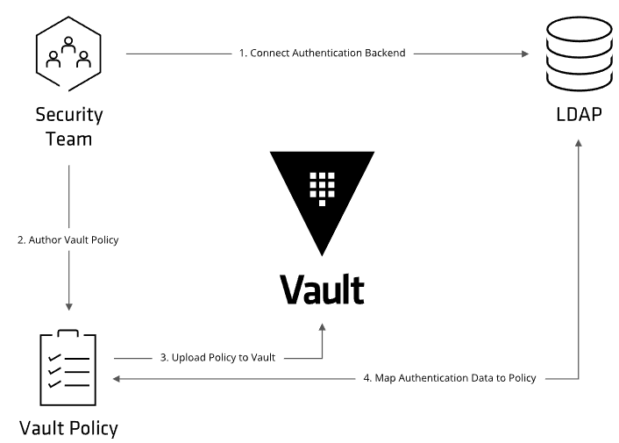
Vault Policy
Everything in Vault is path-based, and policies are no exception. Policies provide a declarative way to grant or forbid access to certain paths and operations in Vault. This section discusses policy workflows and syntaxes. Policies are deny by default, so an empty policy grants no permission in the system
© 2023 Minfy™. Minfy Technologies. All rights reserved
6

Slide 10
THANKYOU
© 2023 Minfy™. Minfy Technologies. All rights reserved
12

